Slide 1
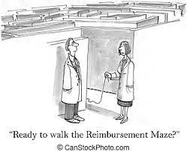
Business Office Reimbursement Process

Slide 2
Business Office
Agenda
Decision Chart
Reimbursements
Employee
Non-Employee
Candidate
Forms Rejected, WHY??
FileLocker
DocuSign
GL List
Contacts

Slide 3
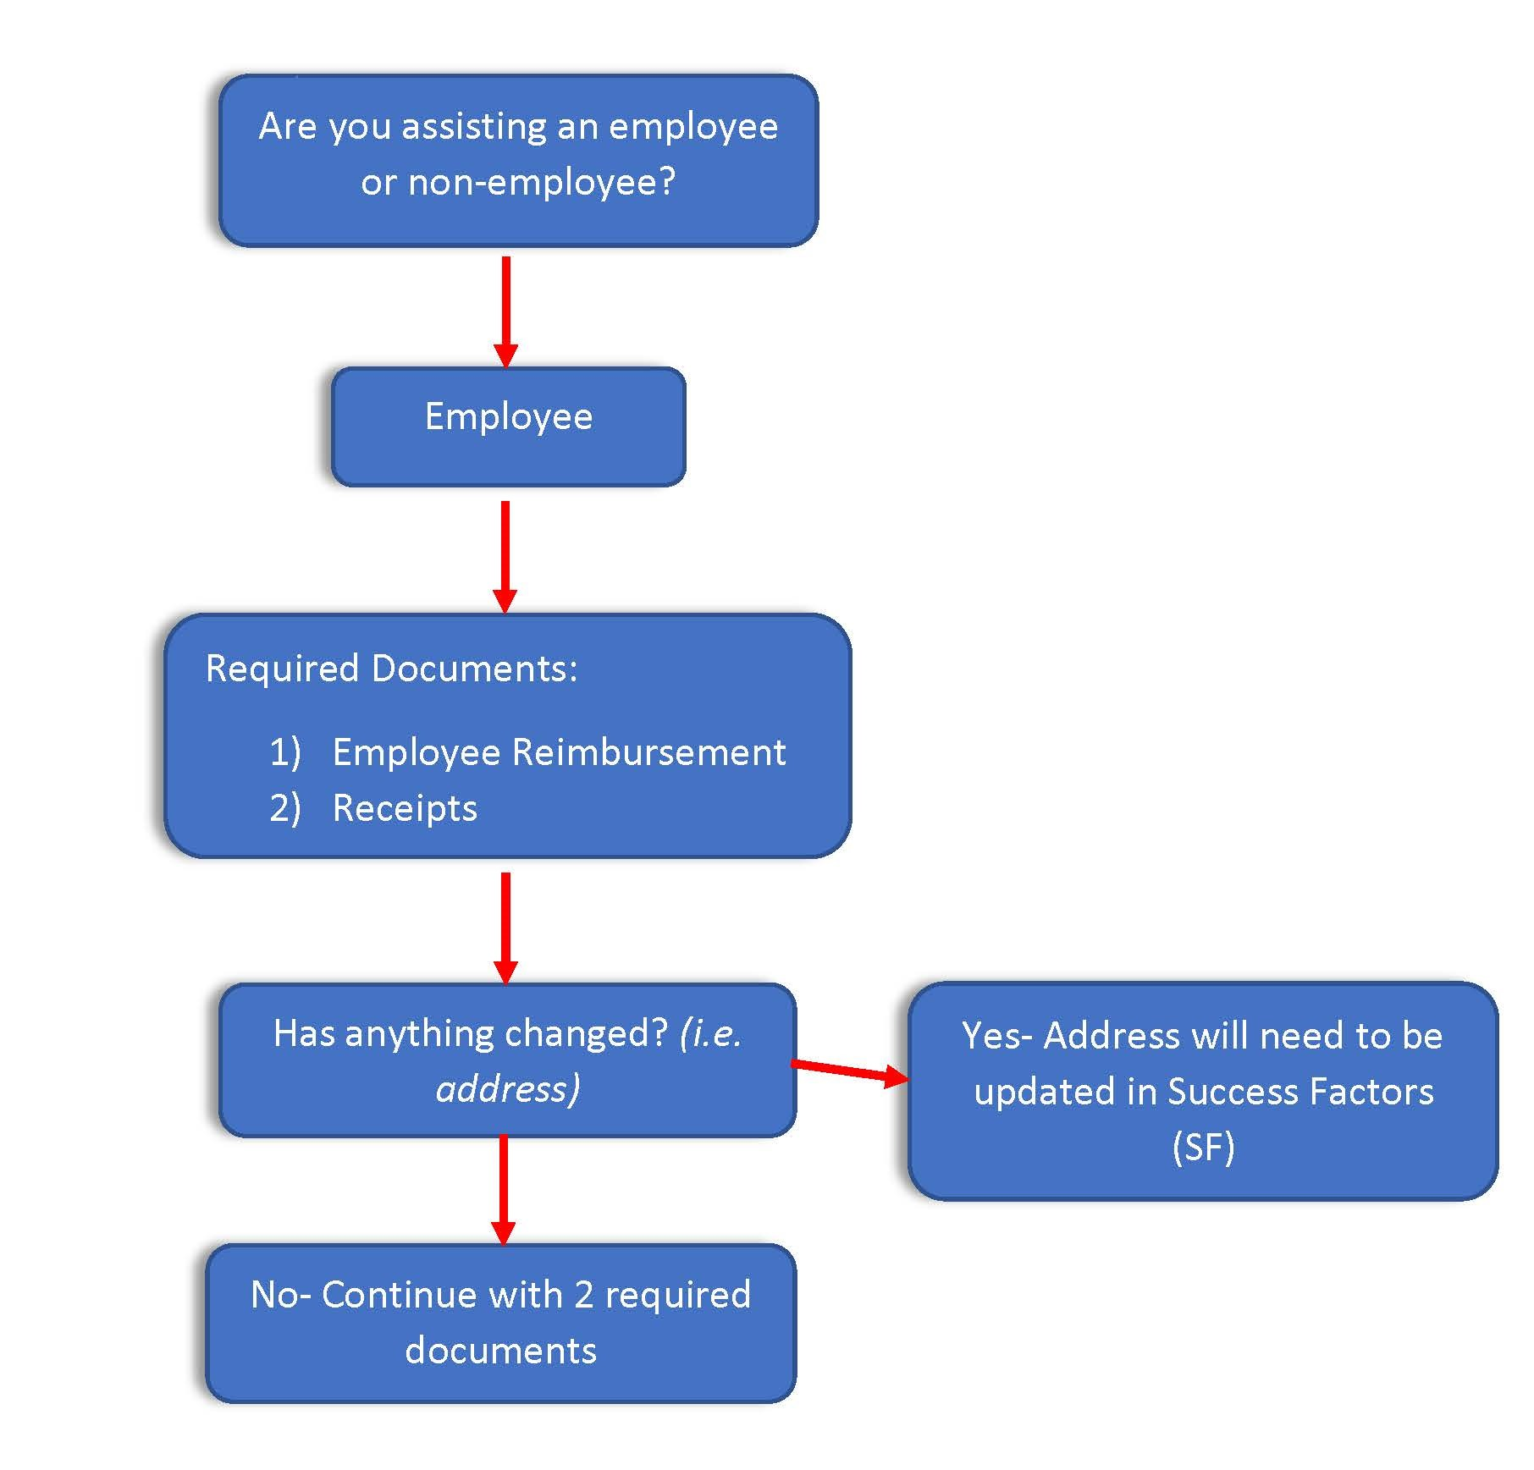
Business Office
Employee Decision Chart

Slide 4
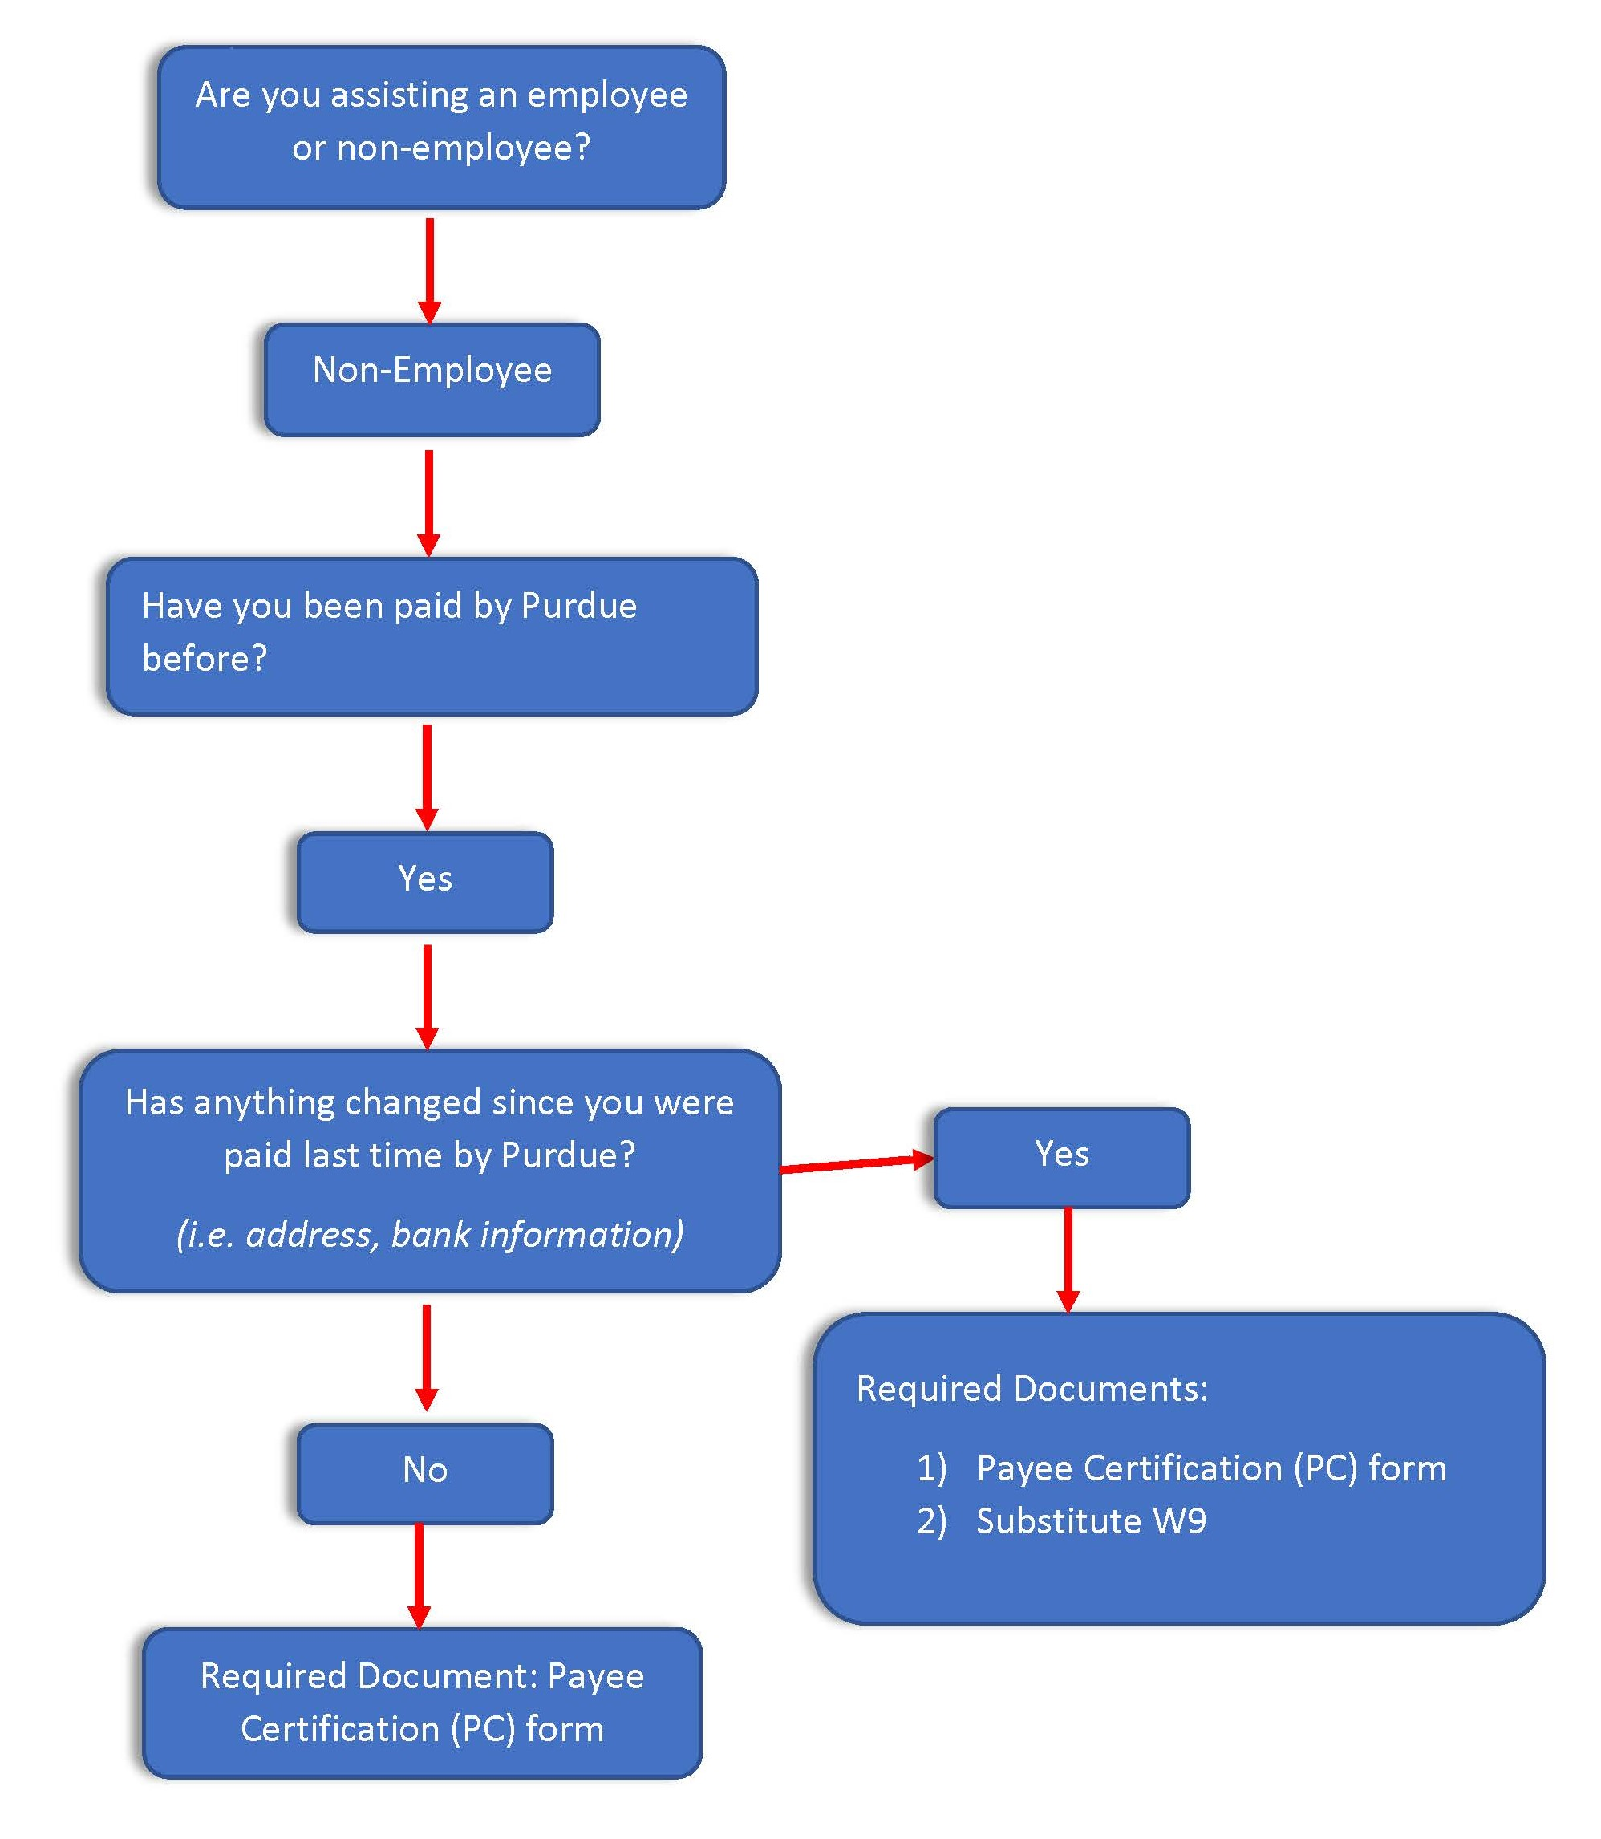
Business Office
Non-Employee Decision Chart

Slide 5
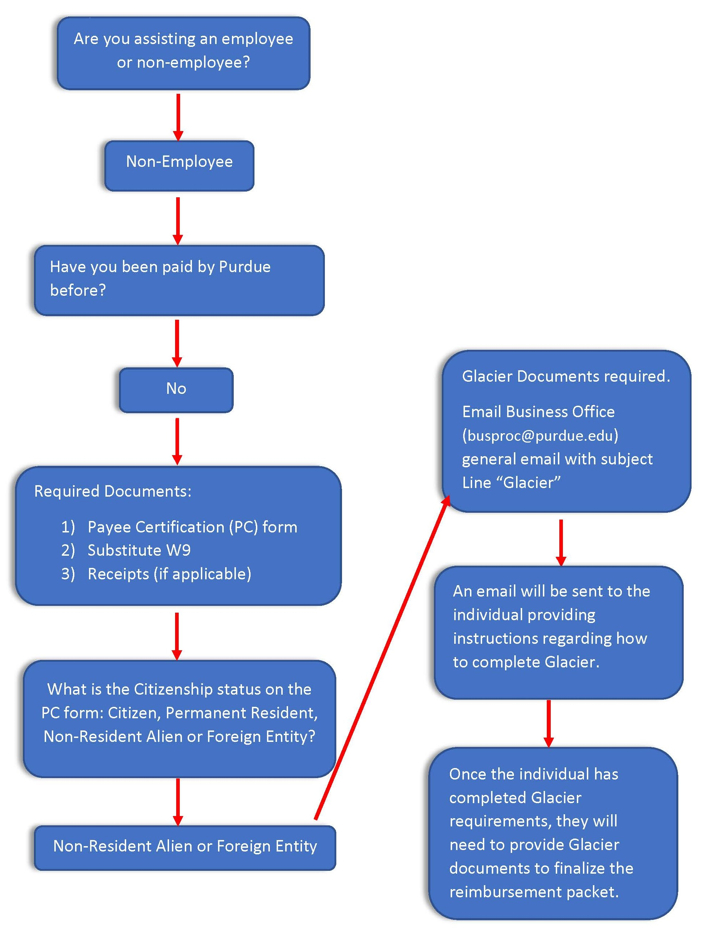
Business Office
Non-Employee Decision Chart

Slide 6
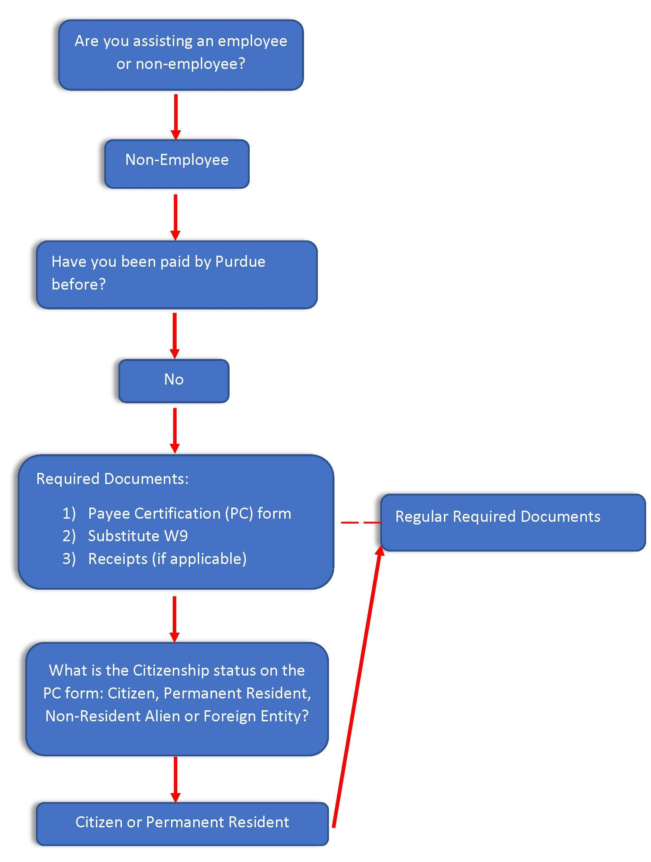
Business Office
Non-Employee Decision Chart

Slide 7
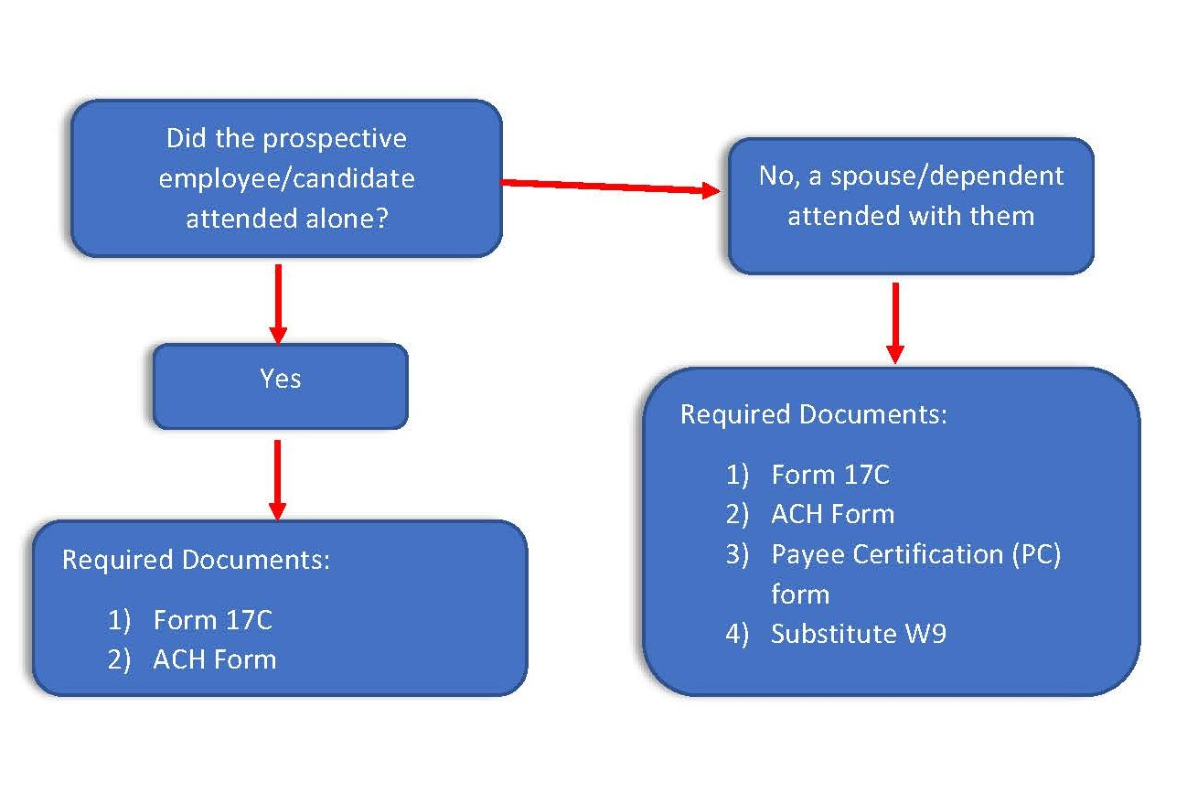
Business Office
Prospective Employee Decision Chart

Slide 8
Business Office
Reimbursements
Employee
Complete Employee Reimbursement Form
Employee requesting the reimbursement should complete
Account number and signature required by the person approving the reimbursement
Requesting area will complete the form’s bottom portion

Slide 9
Business Office
Reimbursements
Employee
Receipts
All receipts must be submitted
Receipts need to show last four digits of the card used to make the purchase
If receipt does not show the last four digits, a bank statement can be submitted (screenshot acceptable) showing the purchase.
The statement needs to show the last four digits of the card
All personal information should be blacked out
If mileage is requested, a Google Map can be submitted showing their route and calculated mileage.
Double the mileage to show the roundtrip total and use that for the total reimbursement
Mileage is currently reimbursed at the rate of 0.655

Slide 10
Business Office
Reimbursements
Non-Employee
The following documents are required for processing:
Payee Certificate (PC)
Completed by the person requesting the reimbursement
Account number and Signature required by the person/area approving the reimbursement
This form must have these items completed
SSN Last 4 digits
Business Type
Reason for Payment
Citizenship Type
PU-related Disclosures section
Itemized Payment section
Digital signature is allowed via DocuSign
Account Information section
The account # will either be an Order or WBS Element (not both)

Slide 11
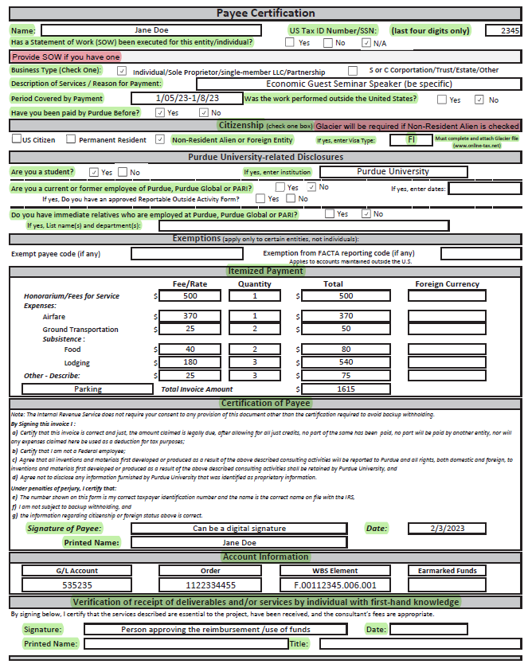
Business Office
Payee Certification (PC) Example

Slide 12
Business Office
Reimbursements
Non-Employee
Substitute W-9
Completed by the person requesting the reimbursement
This form must have these items completed
SSN/TIN (Full)
Email (especially if Glacier is needed)
Address
Telephone Number
Business Type
Citizenship
Purdue University-related Disclosures
Payment Method
Direct Deposit
Checking or Savings
Please inform individual Procurement will be contacting them to verify banking information
Paper Check
Effective 10/1/23: Digital signature is allowed but NOT via Purdue’s DocuSign

Slide 13
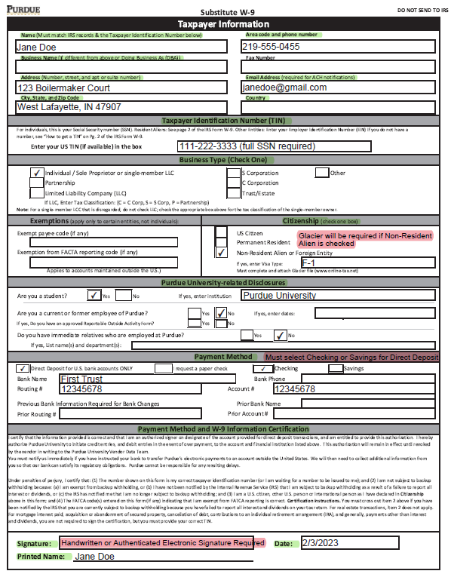
Business Office
Substitute W9 Example

Slide 14
Business Office
Reimbursements
Non-Employee
Glacier
If the Non-Resident Alien or Foreign Entity box is checked in the Citizenship section, Glacier must be completed for tax purposes
Notify the individual that they will receive an email from Glacier that needs to be completed before payment processing (Important to note: these emails can end up in the individual’s junk/spam folder)
Notify the business office (busproc@purdue.edu) that you have a reimbursement for a Non-Resident Alien or Foreign Entity.
Provide the individual’s email
If Purdue student, provide their PUID (sensitive information-send via FileLocker)
The business office will set up an automated email to be sent to the individual
Individual will need to provide I94, I20, Passport/Visa Stamp, and Tax Summary from Glacier (I20 and Tax Summary must be signed with a handwritten signature)
These documents will be required with the reimbursement submission

Slide 15
Business Office
Reimbursements
Non-Employee
Receipts
All receipts must be submitted
Receipts need to show last four digits of the card used to make the purchase
If receipt does not show the last four digits, they can submit a bank statement (screenshot acceptable) showing the purchase.
The statement needs to show the last four digits of the card
All personal information should be blacked out
If mileage is requested, they can submit a Google Map showing their route and calculated mileage.
Double the mileage to show the roundtrip total and use that for the total reimbursement
Mileage is currently reimbursed at the rate of 0.655

Slide 16
Business Office
Reimbursements
Non-Employee
Non-Employee’s Contact?
As the approving area, you are the main contact for the person being reimbursed
Communication will be between you and the person being reimbursed while your area will relay the information they provide to EOBOC
Make sure you are replying to EOBOC emails that contain the FootPrint ticket, if one has been generated
Reminder: Please make sure the non-employee’s email is listed on the Substitute W-9
Documents should be exchanged with EOBOC via FileLocker due to the sensitive information being provided
If reimbursements are for students and there is a max allowed amount, please make sure the allowed amount is noted
Notes:
Program Manager/ person compiling forms should review before sending to the business ofifce

Slide 17
Business Office
Candidate Reimbursement
The following documents are required for processing, if candidate attends alone:
Form 17C
Location – to and from, date traveled, and position they're interviewing for
Section A: Prospective Employee info and travel expenses (note: SSN is only needed if spouse/dependent accompanied prospective employee)
Section B: Complete if Spouse/Dependent accompanied prospective employee
If a Prospective Employee is International, they only need to complete Glacier if they bring a spouse/dependent. Tax considers this a taxable event and requires Glacier.
List Account number and GL Code
Travel expenses listed must match receipts. Receipts must show last four digits of card used for expense.
Approval: Once form is completed, send via DocuSign to Adam Wilson to approve and sign in the (For The President) section.
https://www.purdue.edu/hr/buspur/nonemppay/empreimb.php

Slide 18
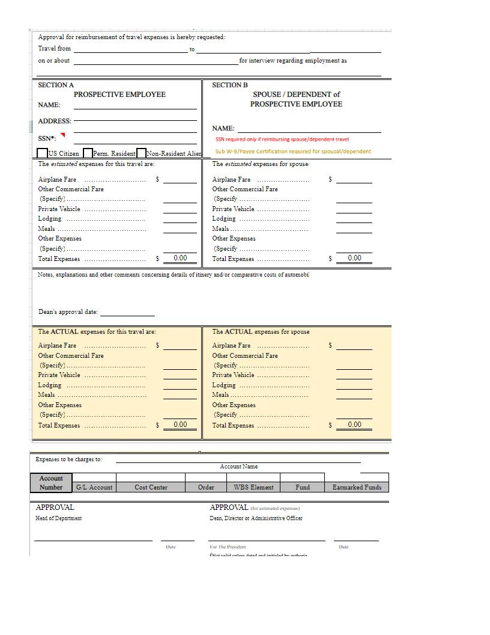
Business Office
Form 17C

Slide 19
Business Office
Candidate Reimbursement
ACH Form
Section 1:
Check the appropriate box for ‘New’ or ‘Change’
Provide complete name, address, phone & email
Enter Tax ID (EIN or SNN) of the payee
If Change, must provide banking information currently on file at Purdue
Section 2:
Provide the name & phone number of the financial institution authorized to conduct transaction
Enter the ABA/routing # of the financial institution (9-digit number)
Enter the account number
Check appropriate box for ‘Checking’ or ‘Savings’
An authorized signer on the bank account must sign this form

Slide 20
Business Office
Candidate Reimbursement
Receipts
All receipts must be submitted
Receipts need to show last four digits of the card used to make the purchase
If receipt does not show the last four digits, they can submit a bank statement (screenshot acceptable) showing the purchase.
The statement needs to show the last four digits of the card
All personal information should be blacked out
If mileage is requested, they can submit a Google Map showing their route and calculated mileage.
Double the mileage to show the roundtrip total and use that for the total reimbursement
Mileage is currently reimbursed at the rate of 0.655
Unless specifically listed, expenses for prospective employees are reimbursed under the regulations governing normal employee reimbursement

Slide 21
Business Office
Candidate Reimbursement
The following documents are required for processing, if candidate attends as a Finalist with Spouse/Dependent:
Form 17C
Location – to and from, date traveled, and position they're interviewing for
Section A: Prospective Employee info and travel expenses (note: SSN is only needed if spouse/dependent accompanied prospective employee)
Section B: Complete if Spouse/Dependent accompanied prospective employee
If a Prospective Employee is International, they only need to complete Glacier if they bring a spouse/dependent. Tax considers this a taxable event and requires Glacier.
List Account number and GL Code
Travel expenses listed must match receipts. Receipts must show last four digits of card used for expense.
Approval: Once form is completed, send via DocuSign to Adam Wilson to approve and sign in the (For The President) section.
https://purdue0.sharepoint.com/:w:/s/BPTraining/busforms/EfIxg9D9qHBLsn7siSzfCOIBsrYcokFwoO0FETivXRMAFw?e=eUCvE6&_ga=2.241742468.747690765.1677503526-584063644.1675345211

Slide 22
Business Office
Candidate Reimbursement
ACH Form
Section 1:
Check the appropriate box for ‘New’ or ‘Change’
Provide complete name, address, phone & email
Enter Tax ID (EIN or SNN) of the payee
If Change, must provide banking information currently on file at Purdue
Section 2:
Provide the name & phone number of the financial institution authorized to conduct transaction
Enter the ABA/routing # of the financial institution (9-digit number)
Enter the account number
Check appropriate box for ‘Checking’ or ‘Savings’
An authorized signer on the bank account must sign this form

Slide 23
Business Office
Candidate Reimbursement
Receipts
All receipts must be submitted
Receipts need to show last four digits of the card used to make the purchase
If receipt does not show the last four digits, they can submit a bank statement (screenshot acceptable) showing the purchase.
The statement needs to show the last four digits of the card
All personal information should be blacked out
If mileage is requested, they can submit a Google Map showing their route and calculated mileage.
Double the mileage to show the roundtrip total and use that for the total reimbursement
Mileage is currently reimbursed at the rate of 0.655
Unless specifically listed, expenses for prospective employees are reimbursed under the regulations governing normal employee reimbursement

Slide 24
Business Office
Candidate Reimbursement
Payee Certificate (PC)
Completed by the Candidate
Expenses noted on the form will only be the amounts incurred from the Spouse/Dependent
This is considered the taxable portion
Account number and Signature required by the person/area approving the reimbursement
This form must have these items completed
SSN Last 4 digits
Business Type
Reason for Payment
Citizenship Type
PU-related Disclosures section
Itemized Payment section
Digital signature is allowed via DocuSign
Account Information section
The account # will either be an Order or WBS Element (not both)

Slide 25
Business Office
Candidate Reimbursement
Substitute W-9
Completed by the Candidate
This form must have these items completed
SSN/TIN (Full)
Email (especially if Glacier is needed)
Address
Telephone Number
Business Type
Citizenship
Purdue University-related Disclosures
Payment Method
Direct Deposit
Checking or Savings
Please inform individual Procurement will be contacting them to verify banking information
Paper Check
Effective 10/1/23: Digital signature is allowed but NOT via Purdue’s DocuSign

Slide 26
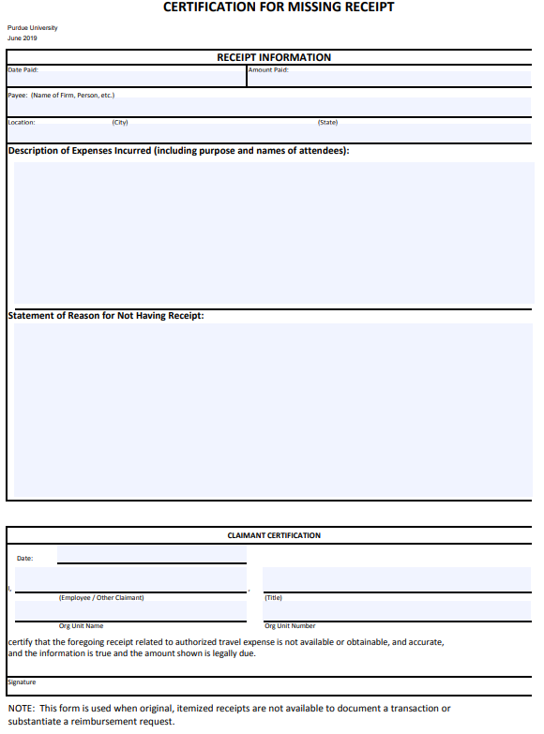
Business Office
Missing Receipt Form
If any expense does not have a receipt or it has been lost, a Missing Receipt form must be attached. https://www.purdue.edu/procurement/documents/missing-receipts.pdf

Slide 27
Business Office
Why is my document being rejected?
Forms completed in different ink colors
Description of Services/Reason for Payment on PC form left blank or too vague (be specific)
No answer to “Have you been paid by Purdue Before” on PC form
Missing signatures
Non-authenticated electronic signature on Sub W9
DocuSign was not used for Digital Signature
on PC From
Signatures are in wrong fields
Reimbursement amount is not provided on PC form
Checking or Savings not marked
Address has changed since last payment/for both the Employee and Non-Employee

Slide 28
Business Office
Why is my document being rejected?
Continued...
Account not provided
GL code not provided
Last 4 digits of the Tax ID field on the PC form is blank
Tax ID is formatted either XXX-XX-XXXX or XX-XXXXXXX on Sub W9
Citizenship is not provided
Type of business is left blank
SOW question is not answered on PC form
EOBOC couldn’t reach individual to verify banking info (Verbal verification is required)
Employee address must match address in Success Factors
All contact information matches what is currently on file

Slide 29
Business Office
How to use FileLocker
Documents should be exchanged with EOBOC via FileLocker due to the sensitive information being provided
Documents need to be sent to EOBOC via FileLocker to bvmaxwel user ID
When submitting documents via FileLocker, must send an email with 'FileLocker:…" as the first part of the subject line
Helpful “How to” use Filelocker
https://www.pfw.edu/offices/banner/resources/cognos-files/FileLocker%20Instructions.pdf
FileLocker is accessed via OneCampus

Slide 30
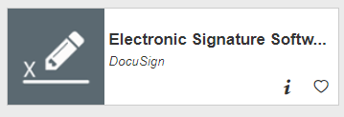
Business Office
How to use DocuSign
Helpful “How to” use DocuSign
For Signers
For Senders
https://www.itap.purdue.edu/services/docusign.html

Slide 31
Business Office
GL List
GL is the code describing the type of expense
Need to use the common GL list provided by the business office
If unsure of what GL code to use, please contact the business office

Slide 32
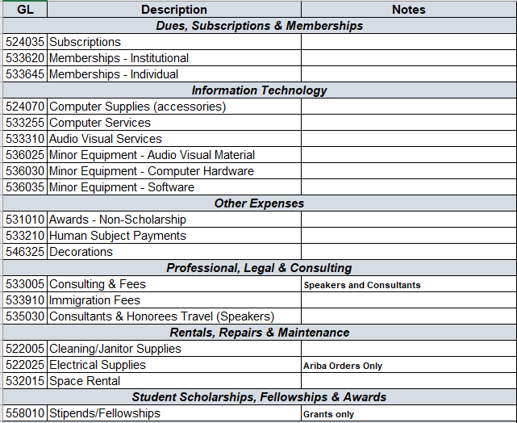
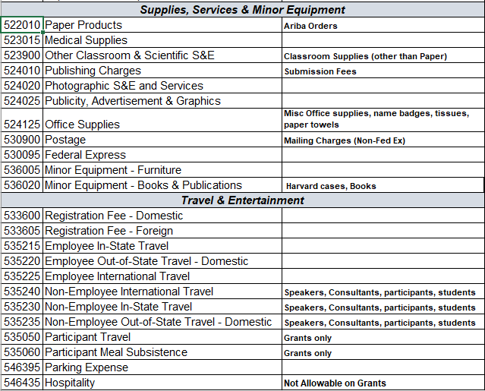
Business Office
Common GL List

Slide 33
Business Office
Tips & Tricks
Review every section of the forms before submitting to EOBOC. Once they send it back with errors to be fixed it delays the person being reimbursed.
EOBOC would like the forms put together in this order, in PDF Format: Payee Cert, Sub W-9, Receipts, and E-mail (Glacier if needed).
Use this format in subject line, and to label the PDF, when sending to EOBOC: Type of Reimbursement (Employee, Non-Employee, Candidate): Name (Last, First) - Amount - Date (example; Employee Reimbursement: Doe, Jane - $150.00 - 2-01-2023)
When sending PDF through Filelocker, list the name of person being reimbursed and what items are in the PDF, in the comment box (example; Jane Doe: Pay Cert, Sub W-9, Receipts, and Email)
Recommend: Keep a log of reimbursements you submit with name, type, date, and amount of reimbursement, as well as the date submitted to EOBOC, date submitted through Filelocker, ticket/issue number, date completed, and document number

Slide 34
Contact Information
EOBOC Procurement:
procureeo@purdue.edu
General Business Office:
busproc@purdue.edu
Saundra (Sandy) Johnson
john1794@purdue.edu
Heather Underwood
hunderwo@purdue.edu
Michelle Gentry
mlgentry@purdue.edu

Slide 35
Business Office Contacts
Adam Wilson, DFA
Reece Dewell, Business Manager
Heather Underwood, Business Manager
Michelle Gentry, Lead Business Asst.
Sandy Johnson, Business Asst.
Patty Whaley, Financial Analyst

Slide 36
Business Office

Slide 37
Business Office

